Slide 1



Week 7-10 Summary
ECE 499 Adam Dulay

Slide 2
Current State of capability
16-bits
Data Bus
16-bits
Control Logic
A
B
16-bits
C
16-bits
D
Memory
E
Inst. Mem
Modules Completed
ALU
Register File
Stack Pointer
Program Counter
Memory
RAM
Instruction Memory
Modules To Do:
Control Logic
Data bus/top file
F
16-bits
RAM
16-bits
16-bits
16-bits
16-bits
SP
+
16-bits
PC
16-bits

Slide 3
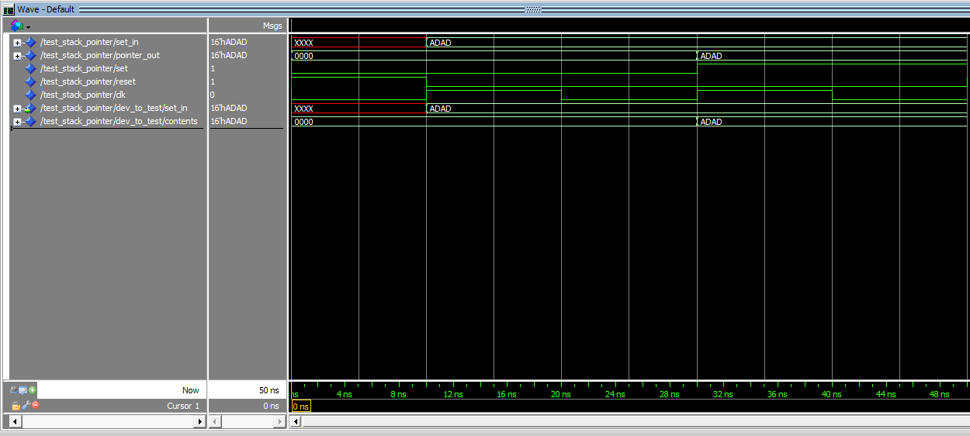
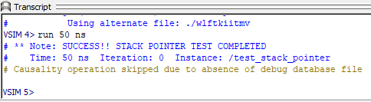
Testbench for stack pointer
Tested with “0xADAD” as an arbitrary testing load value
Testbench simply resets contents, tests non-loading case, and loading case
“non-loading” case is when a values is present without the “enable” signal

Slide 4
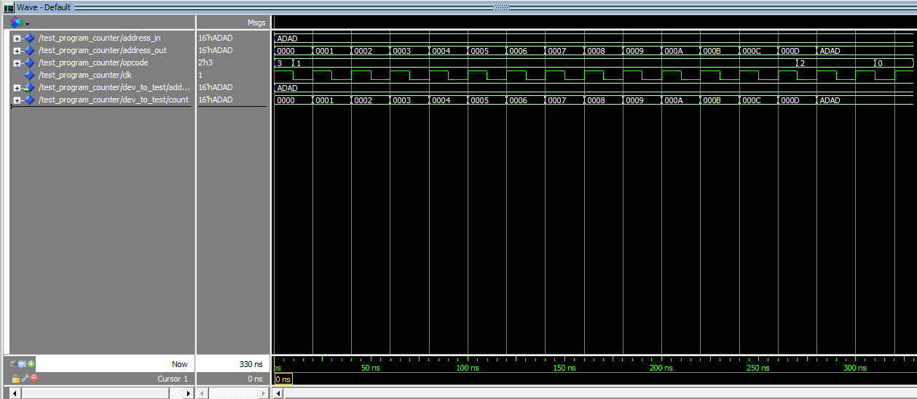
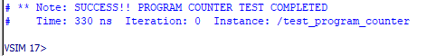
Testbench for program counter
Tested with “0xADAD” as an arbitrary jump address value
Testbench simply feeds it clock signals, then loads a value into the PC (simulating a jump operation), and then resumes incrementing every clock cycle

Slide 5
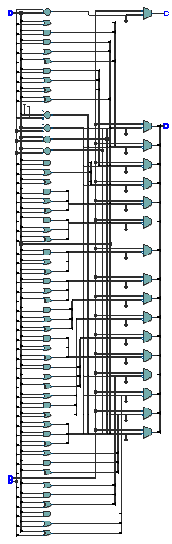
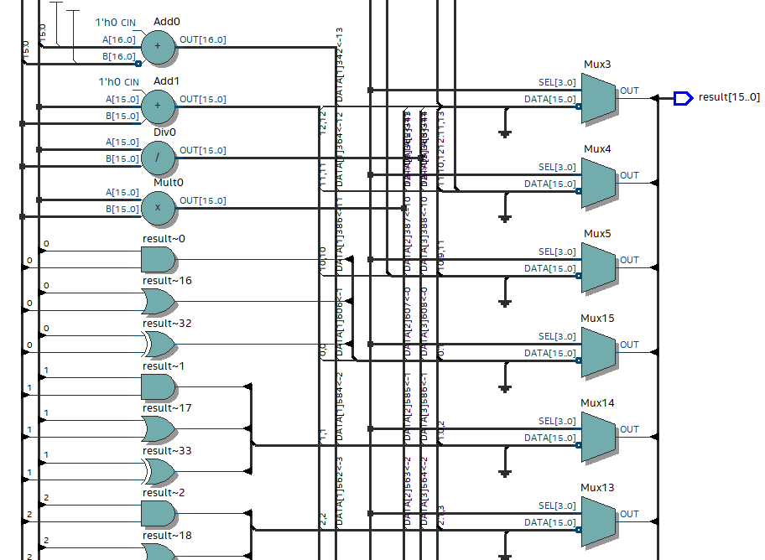
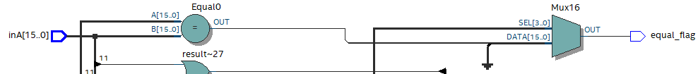
Completed ALU Design
Overall view, zoomed-in view of arithmetic section, and zoomed-in view of the equal flag section
Implemented asynchronously without latches (MUXes, and/or gates and built-in adders, subtractors, multipliers, and dividers
Multiplication only operates on the operands’ 8 LSBs due to the definition of binary multiplication (N-bit input, 2N-bit output)

Slide 6
What Next?
Completed testbenches for ALU and register file (waiting on getting a “better” register file module implementation
FSM implementation of Control Unit
Top File (data bus and inter-module connections)
Tests against IEEE paper benchmark

Slide 7
Questions?

